Slide 1
Unit 1 – revision – vocabulary

Slide 2
Unit 2 inventive solutions

Slide 3
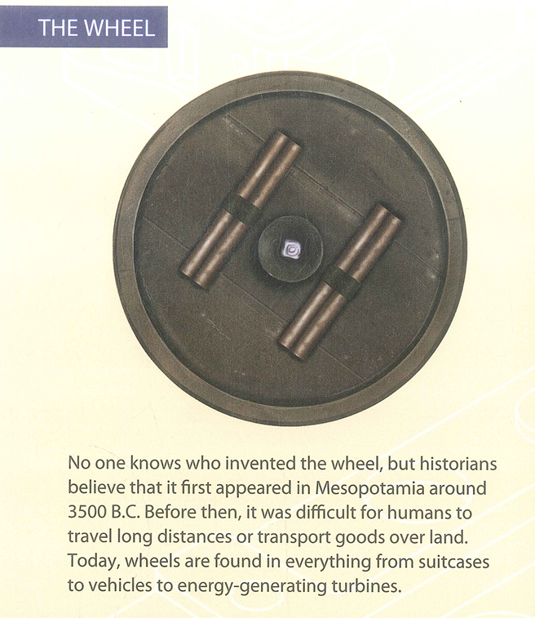
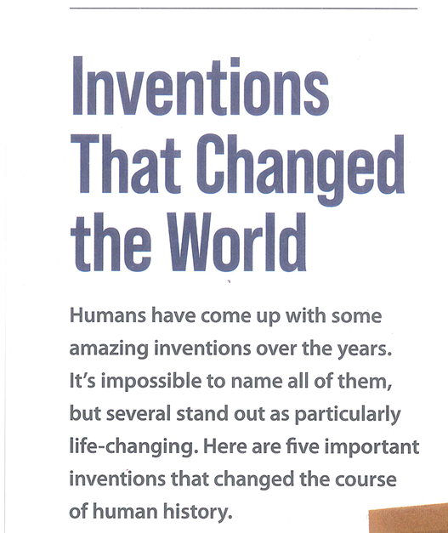
Lead – in
/ˈtɜː.baɪn/; /ˈtɝː.bɪn/

Slide 4
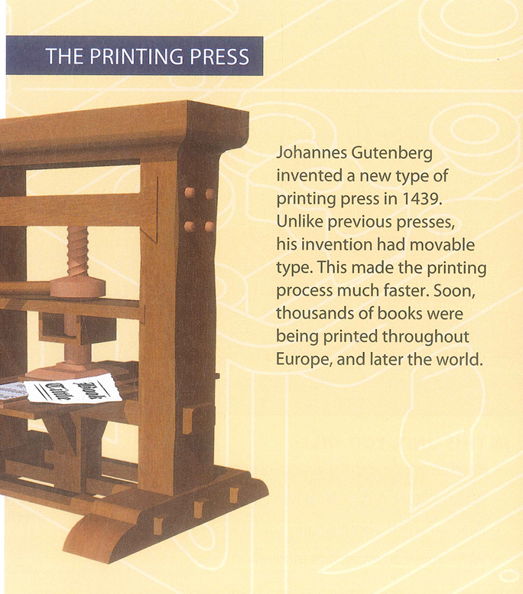
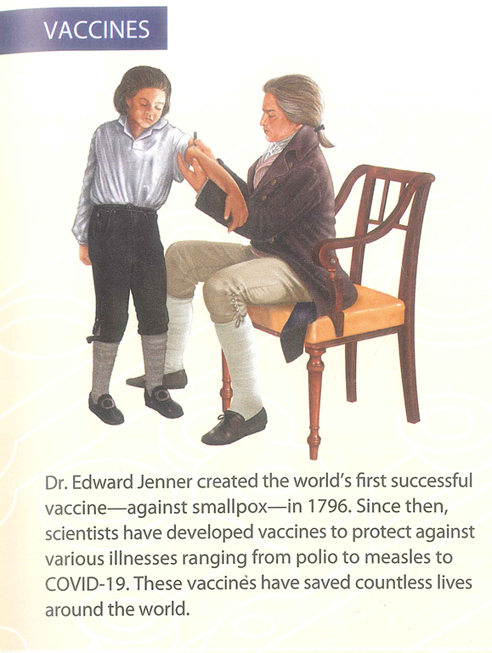
a machine that prints books, newspapers, or magazines
Smallpox: an extremely infectious disease
that causes a fever, spots on the skin, and often death.
Polio: a serious infectious disease that can cause permanent paralysis (= being unable to move the body)
Measles /ˈmiː.zəlz/: an infectious disease that produces small, red spots all over the body

Slide 5
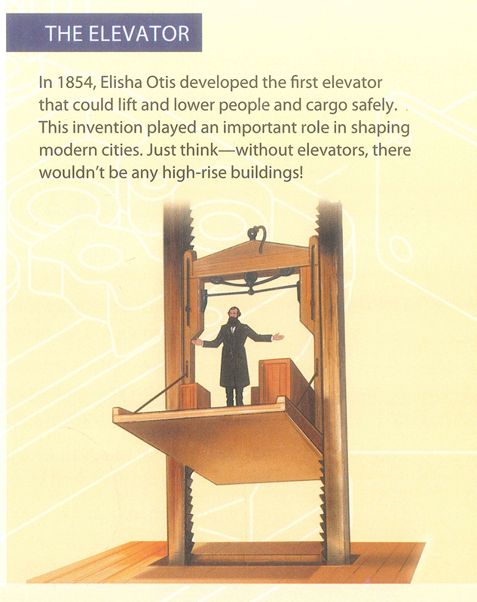
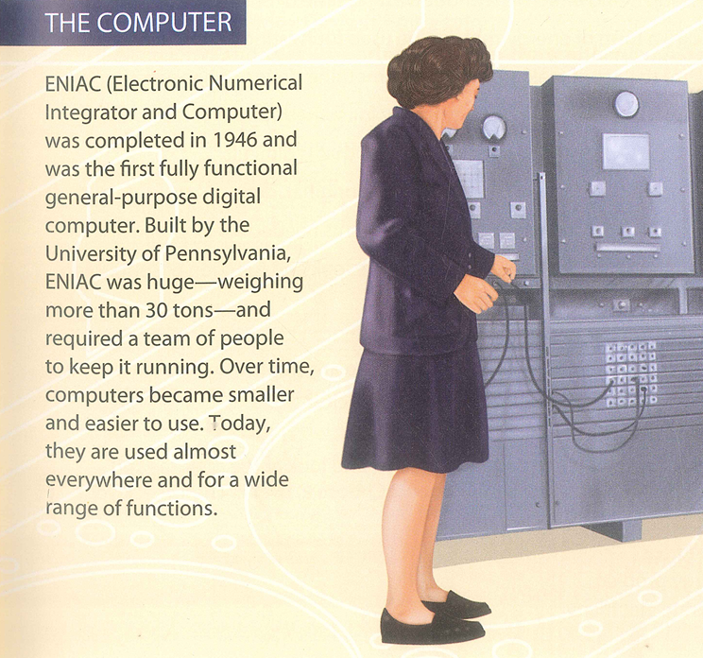

Slide 6
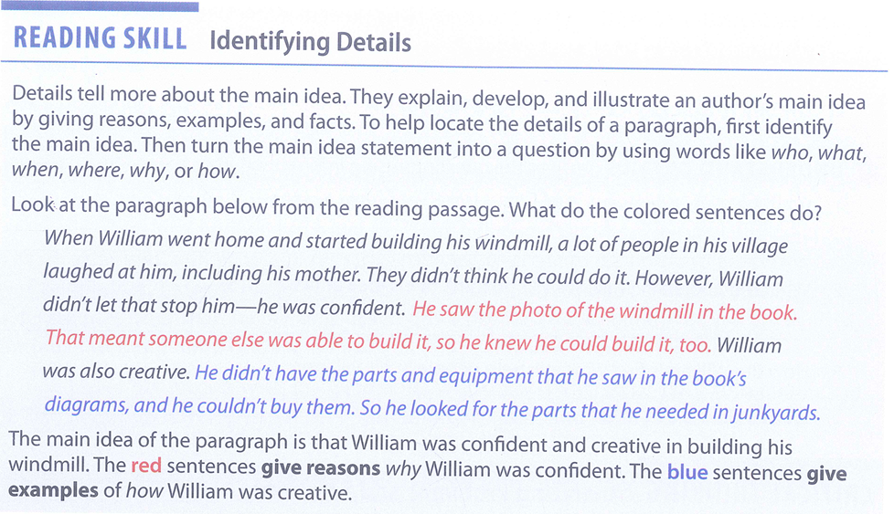
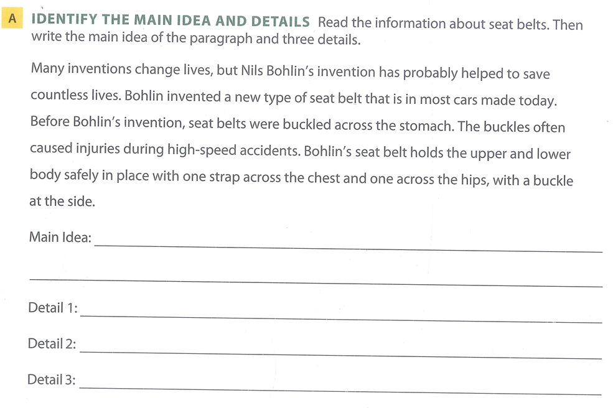


Reading 1 – reading Skill – identifying details
Nils Bohlin invented a new type of seat belt that has helped to save countless lives.
Invented a new type of seatbelt in most cars today
Reason why he was confident
before, seat belts buckled across stomach, which caused injuries
Examples of how he was creative
Bohlin’s seat belt holds upper and lower body in place, with buckle at the side

Slide 7
Reading 1
Build vocabulary (part A)
Understand details (part B)
Understand the main idea (part A)

Slide 8
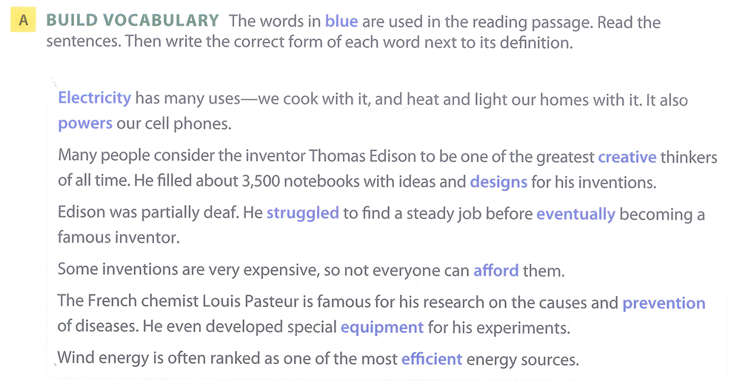
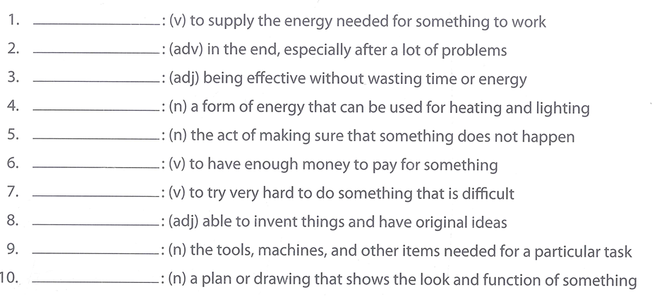
Reading 1 - Building vocabulary
power
eventually
efficient
electricity
prevention
afford
struggle
creative
equipment
design

Slide 9
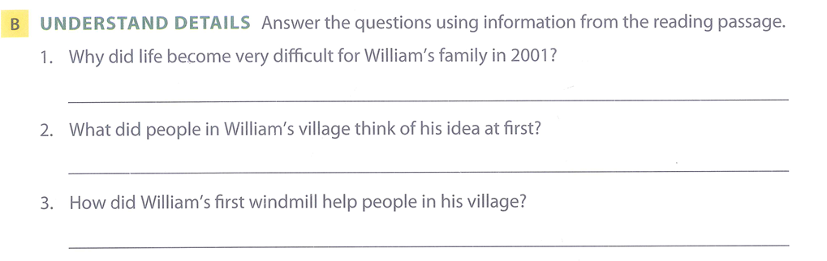
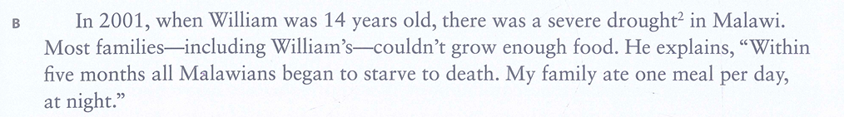
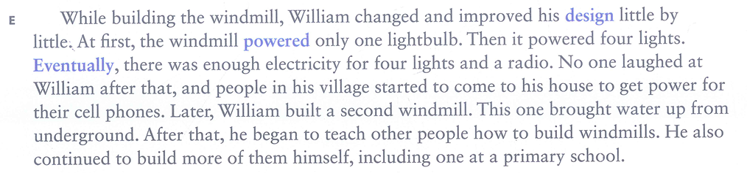
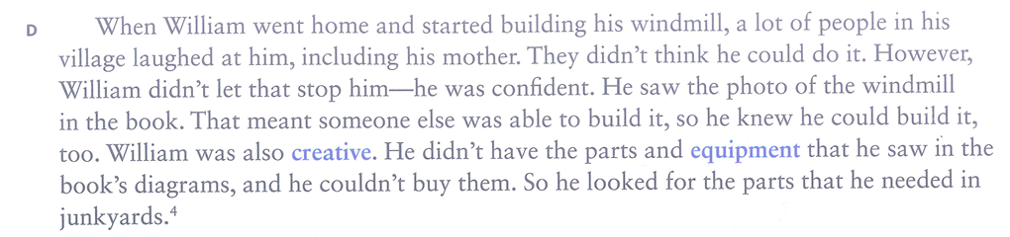




Reading 1 - Reading for details
There was a severe drought in Malawi.
They laughed at him and didn’t think he could do it
They used it to get power for their cell phones.

Slide 10
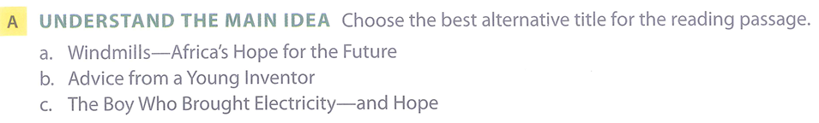
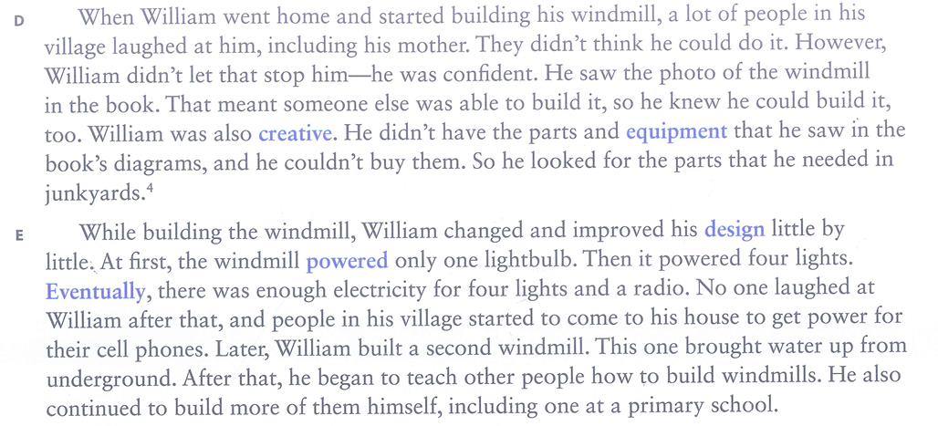
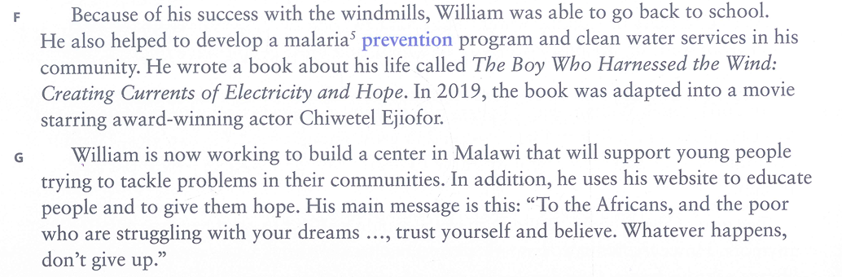

Reading 1 – understand the main idea

Slide 11
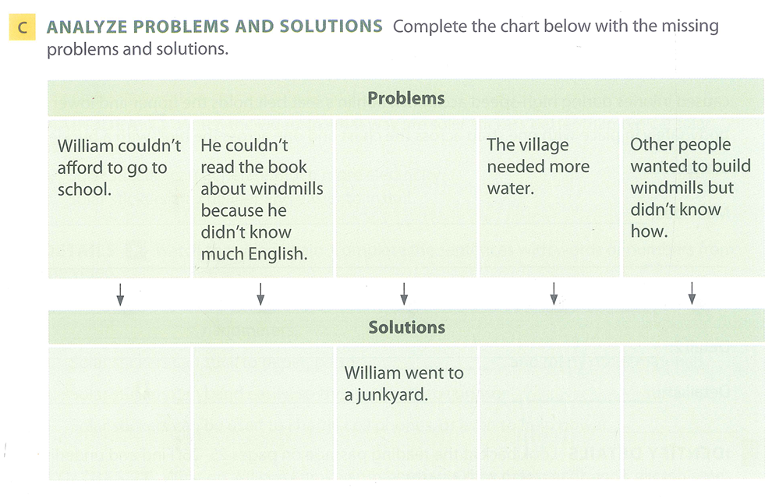
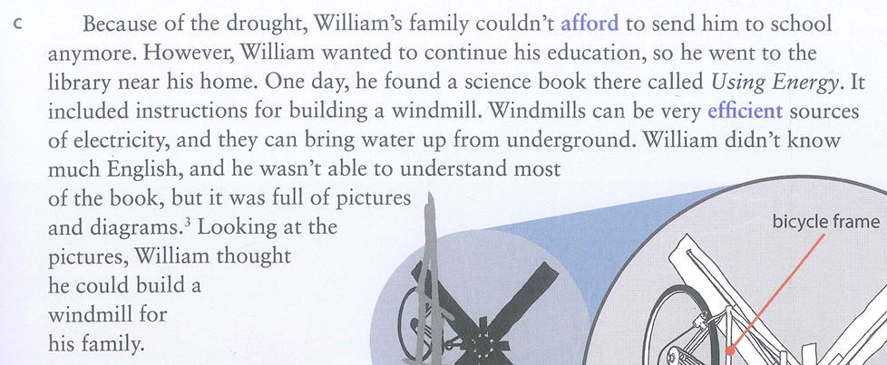
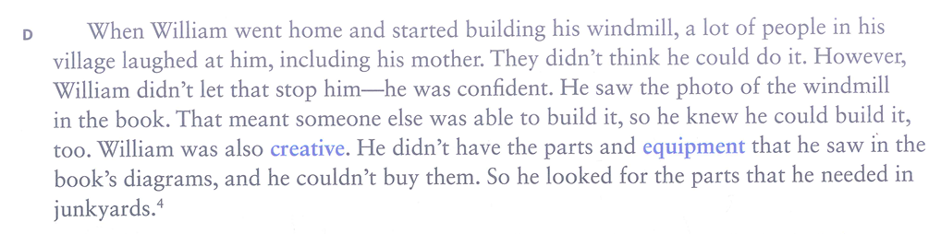

Comprehension check
p.27
He didn’t have the parts and equipment that he saw in the book’s diagrams, and he couldn’t buy them.
He went to the library near his home.
He looked at the pictures and diagrams

Slide 12
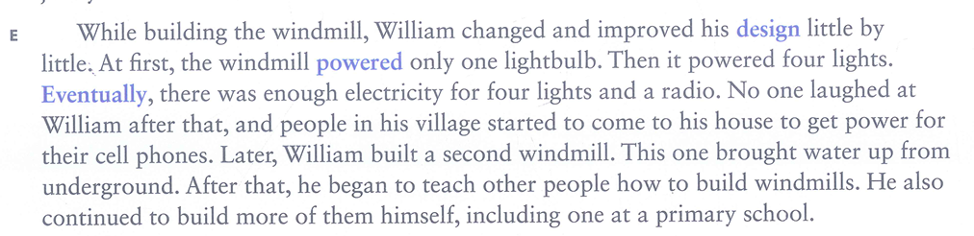


Comprehension check
p.27
He didn’t have the parts and equipment that he saw in the book’s diagrams, and he couldn’t buy them.
He went to the library near his home.
He looked at the pictures and diagrams
William built a second windmill.
William taught other people how to build windmills

Slide 13
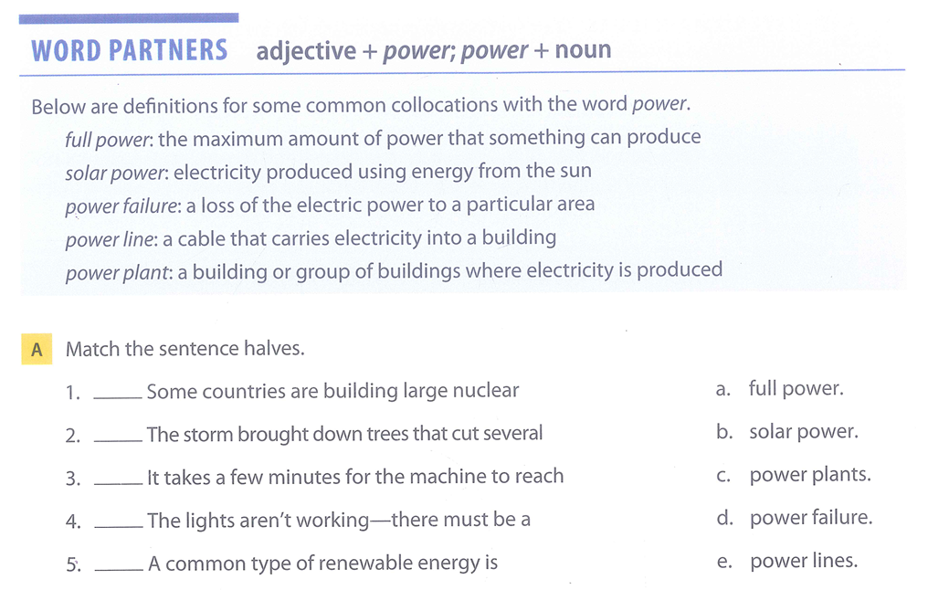
Vocabulary extension
c
e
a
d
b

Slide 14
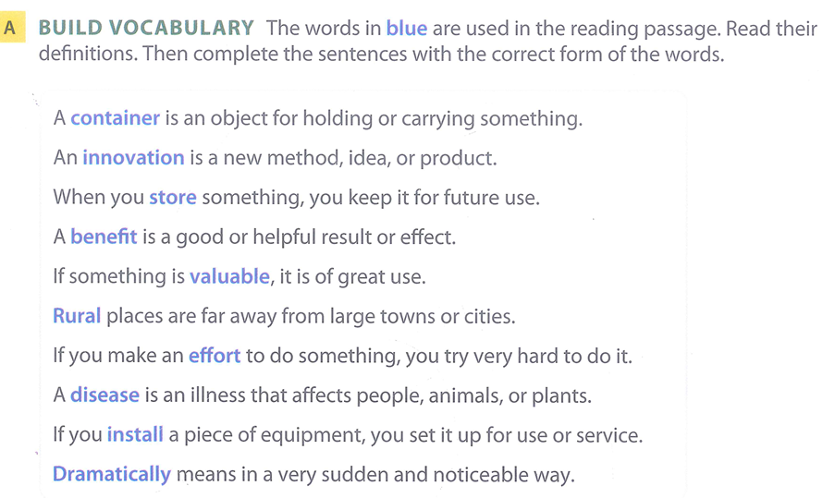
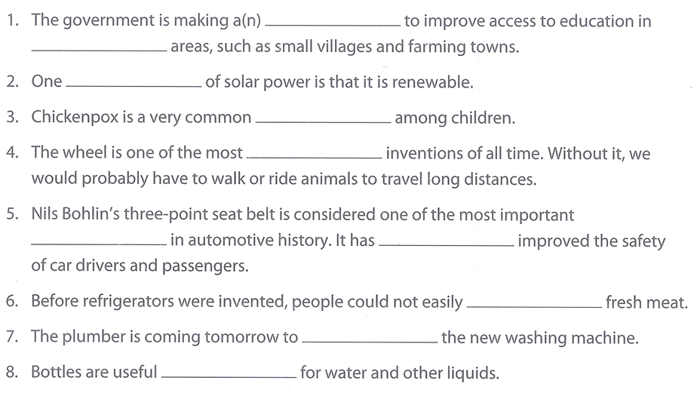
Reading 2 – building vocabulary
effort
rural
benefit
disease
valuable
innovations
dramatically
store
install
containers

Slide 15
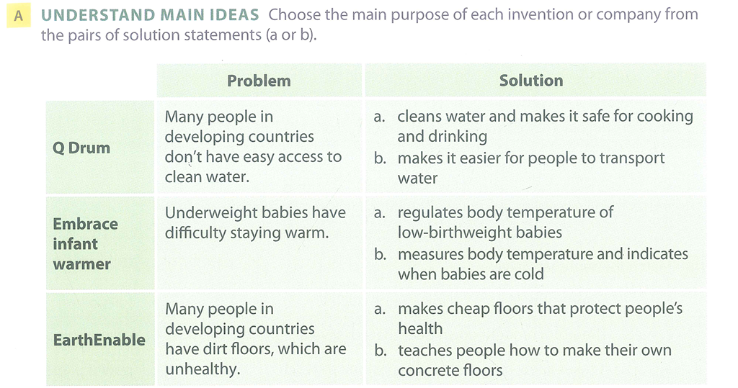
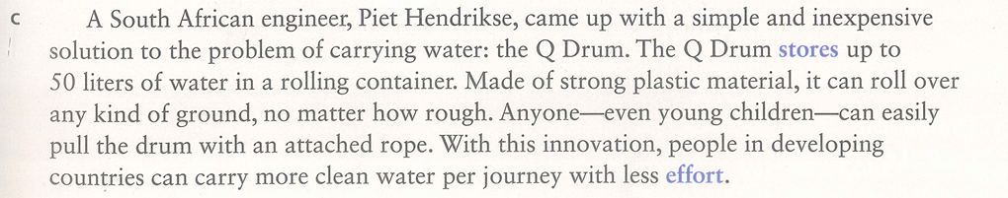
Reading 2 - Understand main ideas

Slide 16
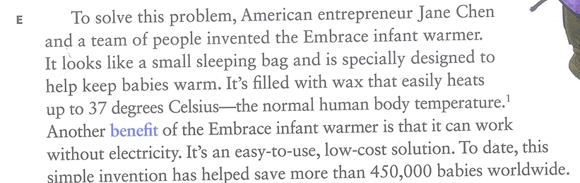
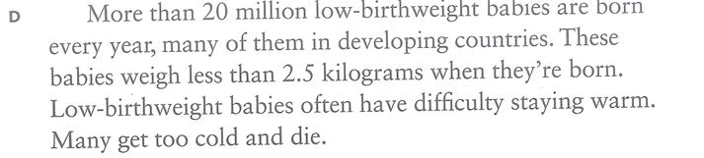
Reading 2 - Understand main ideas
solution
problem

Slide 17
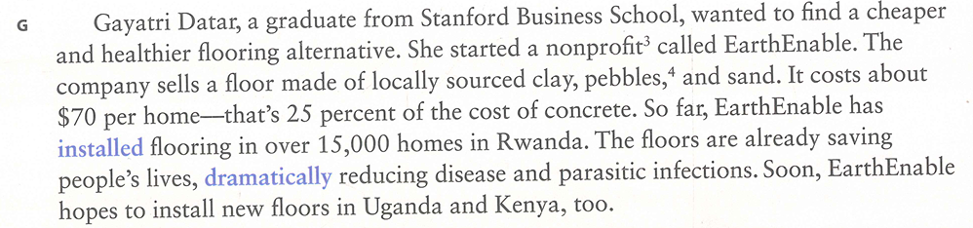
Reading 2 - Understand main ideas

Slide 18
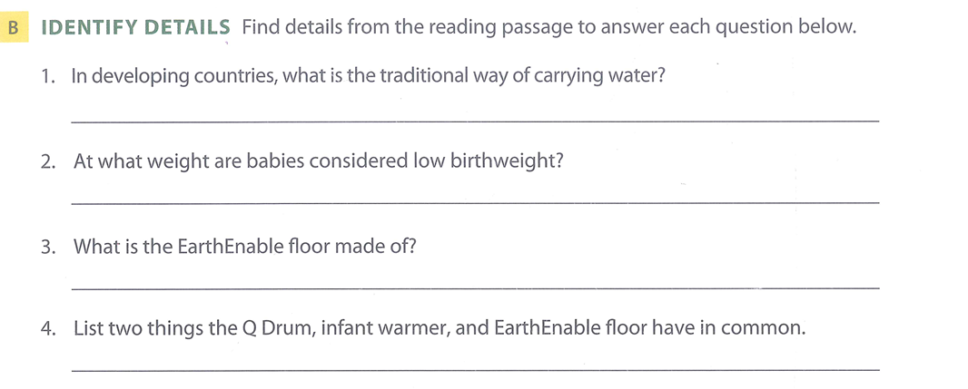
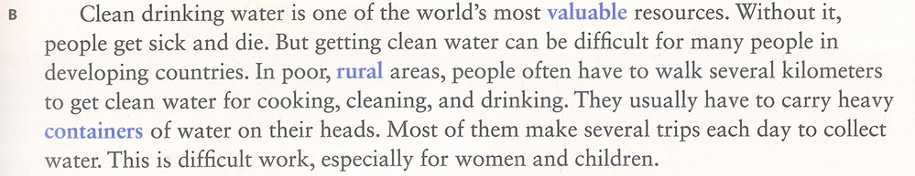
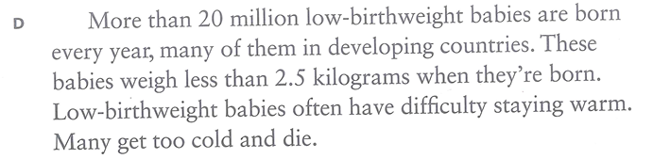
Reading 2 - details
in heavy containers on people’s heads
less than 2.5 kilograms

Slide 19
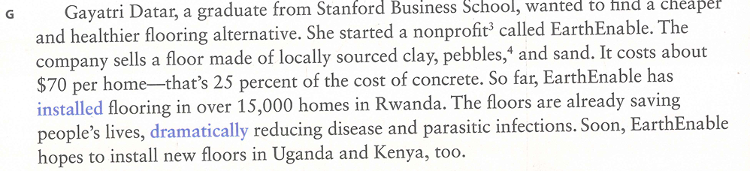
Reading 2 - details
in heavy containers on people’s heads
less than 2.5 kilograms
locally sourced clay, pebbles, and sand

Slide 20
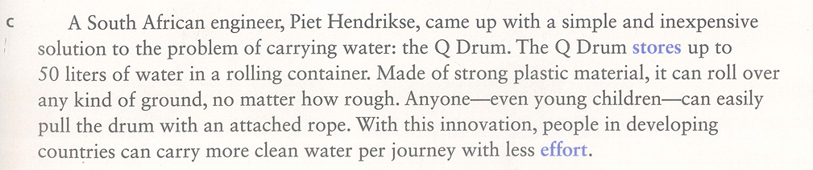
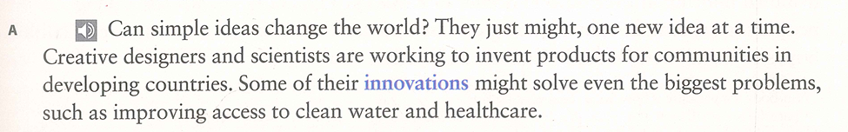
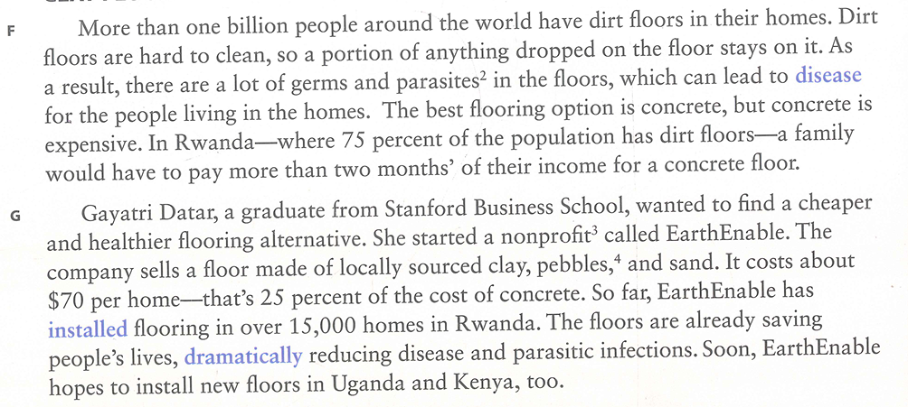
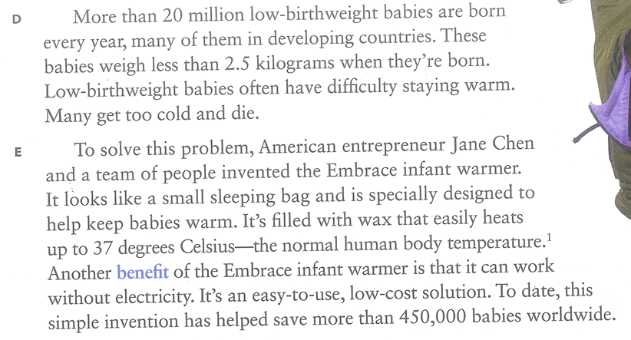







(They are) inexpensive
(they) help people in developing countries they can work without electricity

